Slide 1
GYANGANGA STUDENT PORTAL
To centralize all college related announcements, information and resources

Slide 2
A student portal is an online gateway where students can log into a college website to access important program information. Student portals also contain information on courses offered, transcripts, email programs, timetables, exam schedules and department contact numbers.
What is Student Portal ?

Slide 3
Why we Need ?
A student portal is a website that contains all the required information that a student may need during their college or school years, such as information regarding examination schedules, timetables, how to apply for transcripts, important contact numbers, even a layout of the college or school etc.

Slide 4
Sources That Use in This Project
Code Editor :-
Visual Studio Code (VS Code)
Programming Languages :-
HTML
CSS
JAVASCRIPT
Image Source :-
Google

Slide 5
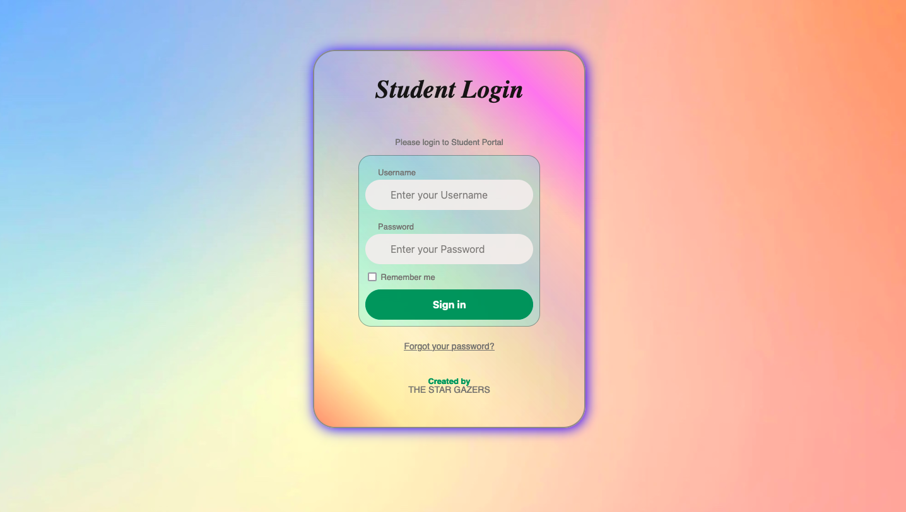
Main-login Portal
In Main Login Screen
Enter Username And Password
Default Username & Password
Username :- admin@gmail.com
Password :- admin

Slide 6
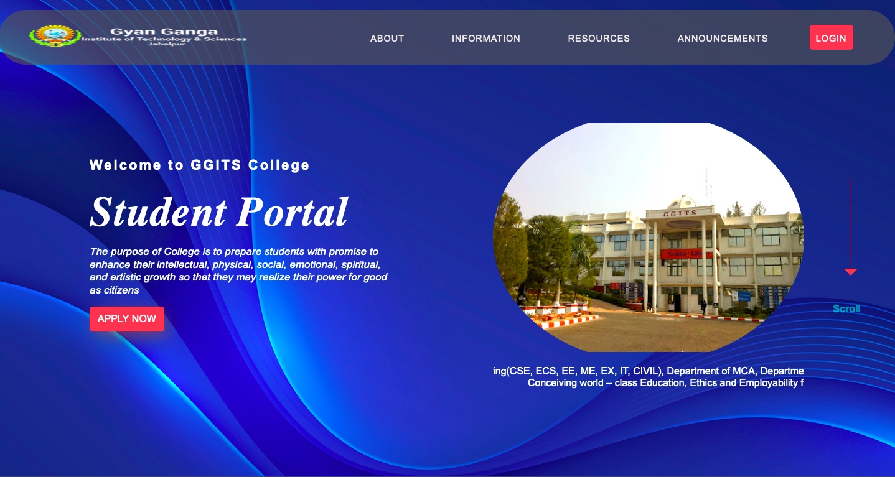
Student Portal Interface

Slide 7
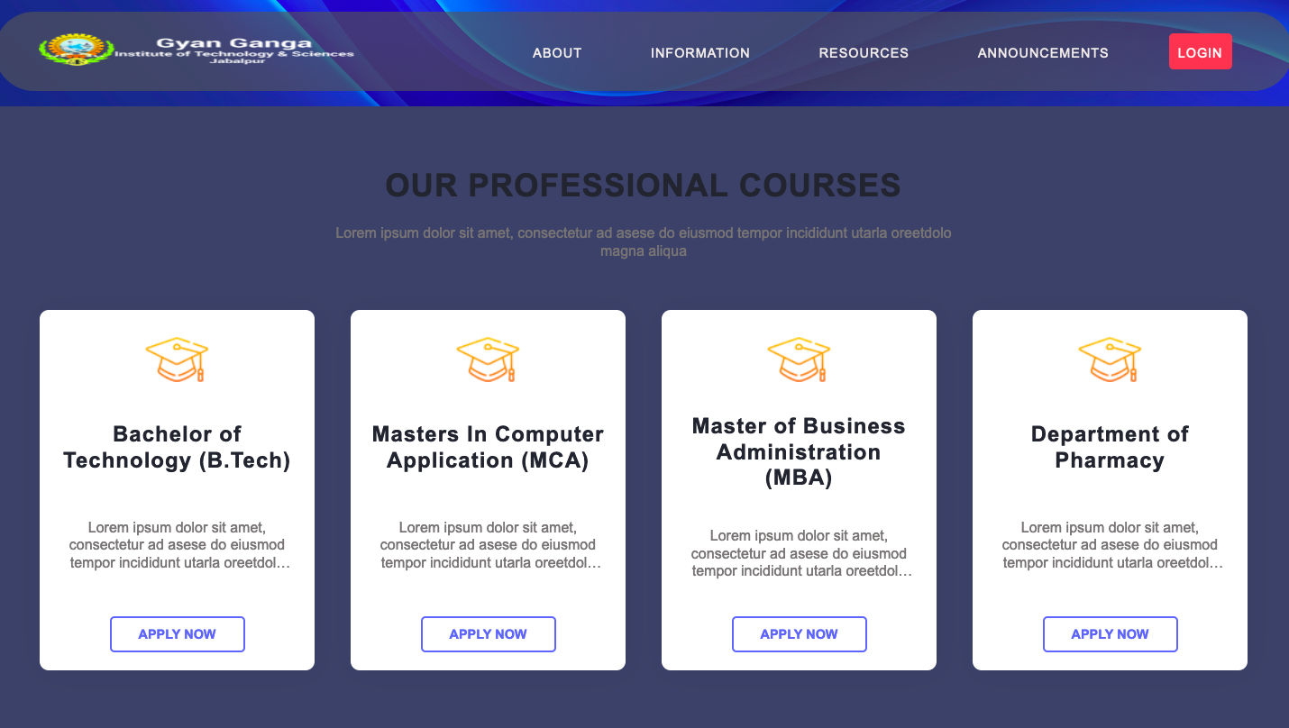
You Will see Here what the college have their courses

Slide 8
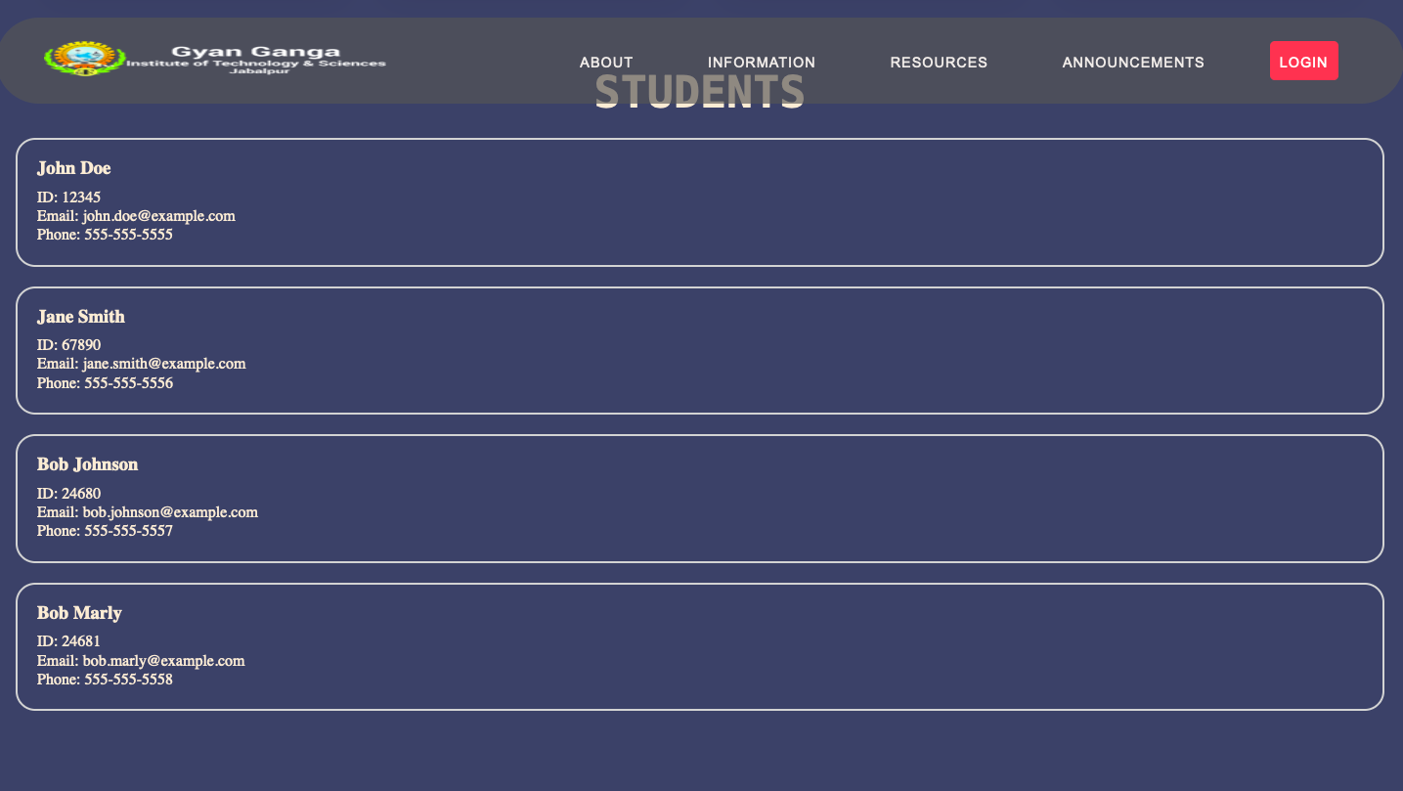
When you Click in Information Button you Will Redirect to Information page That Contain all the information of Students.
Information Page

Slide 9
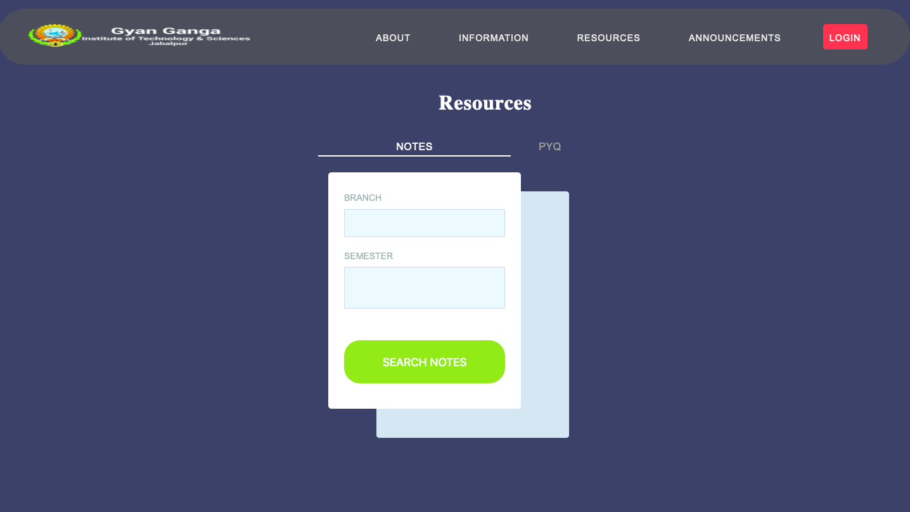
Resource Page contain all the Notes & PYQ that the user want
Resource Page

Slide 10
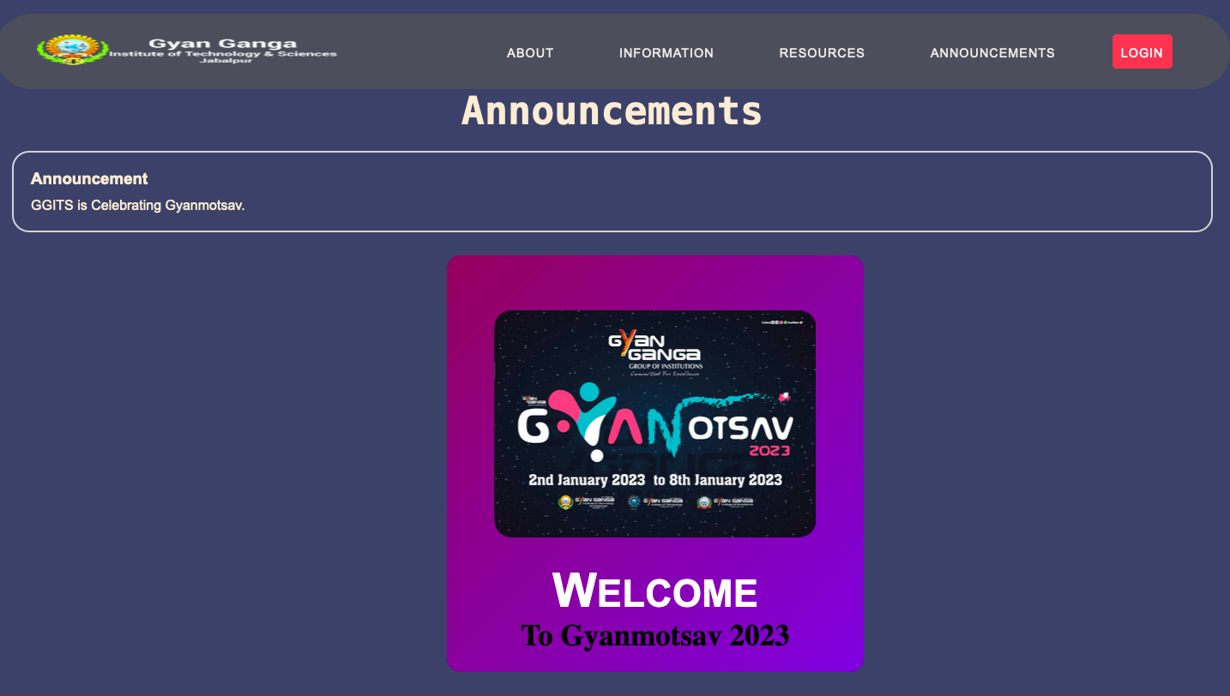
Announcement Page
Announcement Page Contain
All the College Related Announcement like what event is running or what is upcoming.

Slide 11
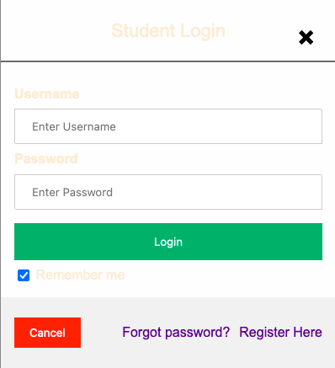
Student-login Page
Student-login page for
login the profile
of the student what’s
inside their profile and
what resource that they have.

Slide 12

Thanks!
This Project was made by :-
Aryan Jain (CSBS 1st Sem)
Sujal Jain (CSD 1st Sem)

